Slide 1

Customer Sales Data Processing and Analytics

Slide 2

01
Generate the Synthetic Data
20,000
Since there's no real customer database, the project creates fake but realistic data using the Faker library.
Set to the Indian locale (en_IN) — so names, phone numbers, and addresses look authentically Indian.
Builds three datasets — Customers, Products, and Orders — each in its own script.
Uses fixed seeds (Faker.seed(42), random.seed(42)) so every run produces the exact same data — useful for consistent testing
.
Generates 20,000 customer records per run, saved into Raw_Data/*.csv.
Right after generating clean data, it deliberately injects errors — bad phone numbers, missing emails, invalid dates — to simulate real-world messy data for the pipeline to clean later.
customer records generated per run
KEY FILES
data_generation.py
data_injection.py
Customer Sales ETL Pipeline | Stage 1: Generate
2

Slide 3


02
Extract and Profile the Raw Data
Measuring how messy the data is before fixing anything
Extraction — raw CSV files (Customers, Products, Orders) read into memory as-is, no changes made.No inspection here.
Inspection before cleaning — every issue counted & logged from raw data first
Customers — invalid phone numbers, missing emails, bad registration dates, duplicate rows/Customer_IDs
Products — missing names, missing category/sub-category/supplier, invalid prices, duplicate rows/Product_IDs
Orders — invalid dates, invalid quantities, unrecognized payment methods/statuses, duplicate rows/Order_IDs
Orders (referential check) — invalid Customer_ID or Product_ID references
Profiling
Inspecting exactly what's broken before any correction is applied
KEY FILES
data-profiling.py
Reality check: there is no separate 'profiling report' generated up front — profiling is inline logging inside the cleaning functions, not its own dedicated stage.
Customer Sales ETL Pipeline | Stage 2: Profile
3

Slide 4

03
Clean,Validate and Standardize
One dedicated module per entity, same disciplined pattern
3
Data types corrected — every column converted to its proper type, so nothing downstream breaks.
Duplicates removed — exact duplicate rows dropped first, then duplicate IDs, keeping only the first occurrence.
Formatting standardized — text fields trimmed and title-cased for consistency.
Every field validated — checked against proper format, valid range, or fixed allowed values.
Records split into Clean vs Rejected — each failure tagged with its reason for full traceability.
Data Quality Report — summarizes cleaning results by counting total, clean, and rejected records per entity.
dedicated cleaning modules — one per entity
KEY FILES
customer_cleaning.py
product_cleaning.py
order_cleaning.py
data_quality_report.py
Customer Sales ETL Pipeline | Stage 3: Clean
4

Slide 5

04
Transform
Merging cleaned entities into one revenue-ready dataset
1
Sales_Transaction.csv merges the three cleaned datasets — Customers, Products, Orders — into one unified table.
Join logic follows Orders → Customers on Customer_ID, then → Products on Product_ID, both as inner joins so only fully-matched, valid records survive.
A new calculated field, Total_Amount, is added as Quantity × Price.
A business rule ensures only orders with Order_Status "Completed" count toward revenue, while cancelled or pending orders get 0.
Derived time fields — Order_Year, Order_Month, YearMonth — are added from Order_Date for trend analysis.
The result turns three disconnected tables into one analysis-ready dataset with revenue built in, saved as Cleaned_Data/valid_data/Sales_Transaction.csv.
Sales_Transaction dataset produced
KEY FILES
sales_transaction.py
Customer Sales ETL Pipeline | Stage 4: Transform
5

Slide 6

05
Design and Load the SQL Schema
Moving from files to a real, queryable MySQL database
Defined the table structure (schema) for Customers, Products, Orders, and Sales_Transaction in MySQL
Auto-creates the database if it doesn't already exist
Each table cleared (truncated) before loading, so re-runs never create duplicates
Cleaned data inserted in batches of 5,000 records at a time for speed
Result: raw CSV files become a real, queryable database
Schema
KEY FILES
database_loader.py
Customer Sales ETL Pipeline | Stage 5: Schema & Load
6

Slide 7

06
Analysis Layer
Turning clean, loaded data into business answers
SQL
Connects to MySQL and runs queries against the loaded database, not the raw CSVs.
Reads all queries from SQL/business_analysis.sql and splits them for execution.
Runs each query one by one via run_business_analysis().
Answers 5 customer-related questions — total customers, top spenders, inactive customers, frequent buyers, top city.
Answers 6 product/sales questions — top products by quantity & revenue, top category, total revenue, average order value, monthly trend.
Prints results to console — column headers, first 10 rows, and total row count per query.
queries power every business metric
KEY FILES
sql_analysis.py
Customer Sales ETL Pipeline | Stage 7: Analyze
8

Slide 8

07
Present Insights
Packaging results into reviewable, shareable output
CSV
Takes everything the pipeline has done and turns it into two final, shareable outputs.
Creates a Data Quality Report — a CSV showing how many records were processed, cleaned, and rejected for each dataset.
Shares the business results from the analysis step — revenue, top customers, top products, monthly trends.
Keeps a full run log (etl_pipeline.log) so anyone can see exactly what happened, step by step, with timestamps.
+ log output — the final deliverables
KEY FILES
data_quality_report.py
Data_Quality_Report.csv
etl_pipeline.log
Customer Sales ETL Pipeline | Stage 8: Present
9

Slide 9




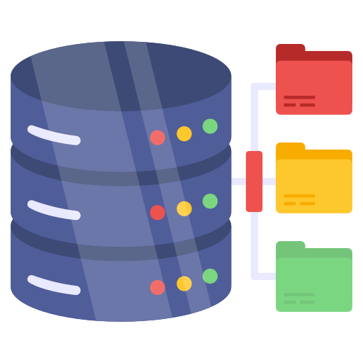

ETL Pipeline Architecture
DATA SOURCES
ETL SYSTEM (Python)
OUTPUTS
Customers.csv
EXTRACT
VALIDATE & CLEAN
TRANSFORM
LOAD
ANALYZE
MySQL Database
(Customers, Products, Orders,
salse_transaction.)
Products.csv
Read raw CSV files
Infer schema & data types
Data profiling
Business rule validation
Handle missing values
Standardize values
Detect duplicates & invalid records
Merge / Join datasets
Derive: Total_Amount
Derive: Order_Year
Derive: Order_Month
Derive: Year_Month
Create Sales_Transaction dataset
Load cleaned data into MySQL database
Maintain PK & FK relationships
SQL & Pandas Analysis
Business Insights
Reporting
Sales_Transaction Dataset
(CSV)
Orders.csv
Generated using Python (Faker, Random)
Contains 12+ months of transaction data
Data Quality Report
(CSV)
Rejected Datasets
(CSV Files)
Business Analysis
(SQL Results)
SUPPORTING COMPONENTS
Python 3.12.08
pandas, numpy
mysql-connector
logging
os
faker, random
MySQL connector

Slide 10
Thank you

